Slide 1



Slide 2




Artificial Intelligence (AI-2002) Lecture 7: Constraint Satisfaction Problems (CSPs)
Dr. Fahad Sherwani (Assistant Professor – FAST NUCES)
PhD in Artificial Intelligence
Universiti Tun Hussein Onn Malaysia
fahad.sherwani@nu.edu.pk

Slide 3
Constraint satisfaction problems
What is a CSP?
Constraint satisfaction problems are mathematical questions defined as a set of objects whose state must satisfy a number of constraints or limitations. CSPs represent the entities in a problem as a homogeneous collection of finite constraints over variables, which is solved by constraint satisfaction methods.

Slide 4
Constraint satisfaction problems
What is a CSP?
Finite set of variables V₁, V₂, …, V_{n}
Non-empty domain of possible values for each variable
D_{V1}, D_{V2}, … D_{Vn}
Finite set of constrains C1, C2, …, Cm
Each constraint C_{i} limits the values that variables can take, e.g., V₁ ≠ V₂
A state is defined as an assignment of values to some or all variables.
Consistent assignment: assignment does not not violate the constraints.

Slide 5
Constraint satisfaction problems
An assignment is complete when every value is mentioned.
A solution to a CSP is a complete assignment that satisfies all constraints.
Some CSPs require a solution that maximizes an
objective function.
Applications: Scheduling the time of observations on the Hubble Space Telescope, Floor planning, Map coloring, Cryptography

Slide 6
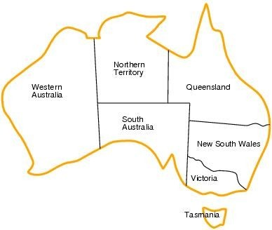
CSP example: map coloring
■
■
■
Variables: WA, NT, Q, NSW, V, SA, T
Domains: D_{i}={red,green,blue}
Constraints:adjacent regions must have different colors.
■
■
E.g. WA ≠ NT
E.g. (WA, NT) ≠ {(red,green),(red,blue),(green,red),…}

Slide 7
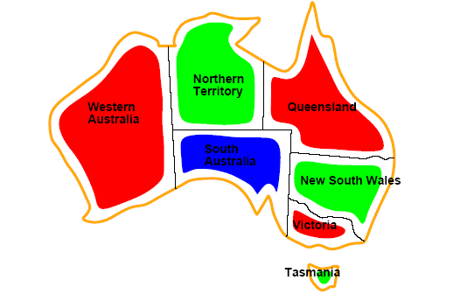
CSP example: map coloring
■
Solutions are assignments satisfying all constraints, e.g.
{WA=red,NT=green,Q=red,NSW=green,V=red,SA=blue,T=green}

Slide 8
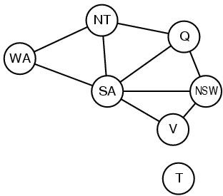
Constraint graph
■
CSP benefits
◻
◻
◻
Standard representation pattern Generic goal and successor functions
Generic heuristics (no domain specific expertise).
■
Constraint graph = nodes are variables, edges show constraints.
◻
Graph can be used to simplify search.
■
e.g. Tasmania is an independent subproblem.

Slide 9
Varieties of CSPs
Discrete variables
Finite domains; size d ⇒O(d^{n}) complete assignments.
E.g. Boolean CSPs, include. Boolean satisfiability (NP-complete).
Infinite domains (integers, strings, etc.)
E.g. job scheduling, variables are start/end days for each job
Need a constraint language e.g StartJob₁ +5 ≤ StartJob₃.
Linear constraints solvable, nonlinear undecidable.
Continuous variables
e.g. start/end times for Hubble Telescope observations.
Linear constraints solvable in poly time by LP methods.

Slide 10
Varieties of constraints
Unary constraints involve a single variable.
e.g. SA ≠ green
Binary constraints involve pairs of variables.
e.g. SA ≠ WA
Higher-order constraints involve 3 or more variables.
e.g. cryptharithmetic column constraints.
Preference (soft constraints) e.g. red is better than green
often representable by a cost for each variable assignment
→ constrained optimization problems.

Slide 11
CSP as a standard search problem
A CSP can easily be expressed as a standard search problem.
Incremental formulation
Initial State: the empty assignment {}.
Successor function: Assign value to unassigned variable provided that there is not conflict.
Goal test: the current assignment is complete.
Path cost: as constant cost for every step.

Slide 12
CSP as a standard search problem
This is the same for all CSP’s !!!
Solution is found at depth n (if there are n variables).
◻ Hence depth first search can be used.
Path is irrelevant, so complete state representation can also be used.
Branching factor b at the top level is nd.
b=(n-l)d at depth l, hence n!d^{n} leaves (only d^{n} complete assignments).

Slide 13
Commutativity
CSPs are commutative.
The order of any given set of actions has no effect on the outcome.
Example: choose colors for Australian territories one at a time
[WA=red then NT=green] same as [NT=green then WA=red]
All CSP search algorithms consider a single variable assignment at a time ⇒ there are d^{n} leaves.

Slide 14
Backtracking search
Depth-first search
Chooses values for one variable at a time and backtracks when a variable has no legal values left to assign.
Uninformed algorithm
◻ No good general performance

Slide 15
Backtracking search
function BACKTRACKING-SEARCH(csp) return a solution or failure
return RECURSIVE-BACKTRACKING({} , csp)
function RECURSIVE-BACKTRACKING(assignment, csp) return a solution or failure
if assignment is complete then return assignment
var ← SELECT-UNASSIGNED-VARIABLE(VARIABLES[csp],assignment,csp)
for each value in ORDER-DOMAIN-VALUES(var, assignment, csp) do
if value is consistent with assignment according to CONSTRAINTS[csp] then
add {var=value} to assignment
result ← RRECURSIVE-BACTRACKING(assignment, csp)
if result ≠ failure then return result
remove {var=value} from assignment
return failure

Slide 16

Backtracking example

Slide 17
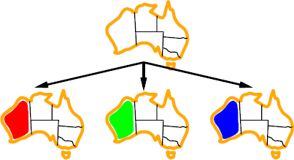
Backtracking example

Slide 18
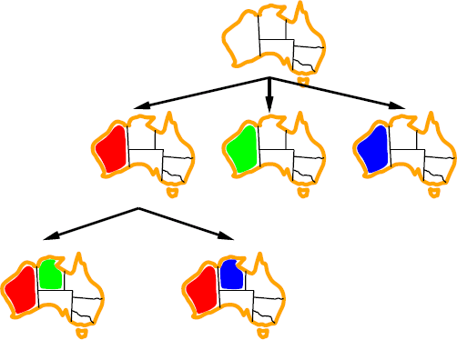
Backtracking example

Slide 19
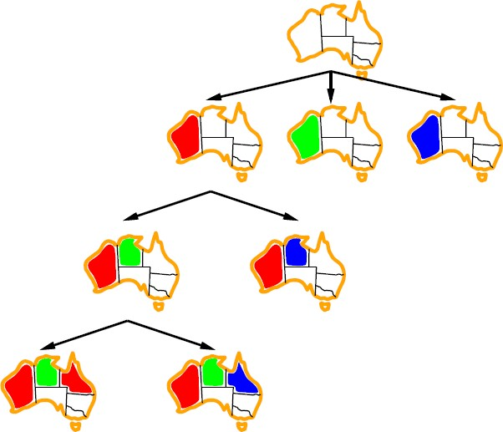
Backtracking example

Slide 20
Improving backtracking efficiency
Previous improvements → introduce heuristics
General-purpose methods can give huge gains in speed:
Which variable should be assigned next?
In what order should its values be tried?
Can we detect inevitable failure early?
Can we take advantage of problem structure?

Slide 21

Minimum remaining values
var ← SELECT-UNASSIGNED-VARIABLE(VARIABLES[csp],assignment,csp)
■
■
■
Also known as most constrained variable heuristic
Rule: choose variable with the fewest legal moves
Which variable shall we try first?

Slide 22

Degree heuristic
■
■
Use degree heuristic
Rule: select variable that is involved in the largest number of constraints on other unassigned variables.
Degree heuristic is very useful as a tie breaker.
In what order should its values be tried?
■
■

Slide 23
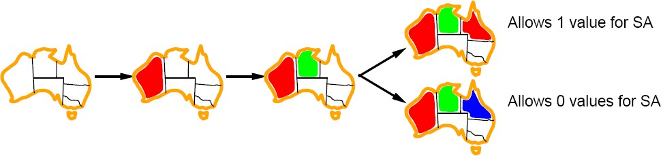
Least constraining value
■
■
Least constraining value heuristic
Rule: given a variable choose the least constraing value i.e. the one that leaves the maximum flexibility for subsequent variable assignments.

Slide 24
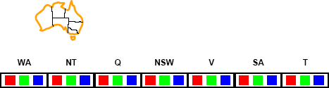
Forward checking
■
Can we detect inevitable failure early?
◻
And avoid it later?
■
Forward checking idea: keep track of remaining legal values for unassigned variables.
Terminate search when any variable has no legal values.
■

Slide 25
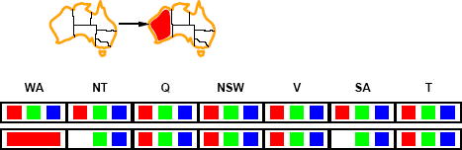
Forward checking
■
■
Assign {WA=red}
Effects on other variables connected by constraints with WA
◻
◻
NT can no longer be red SA can no longer be red

Slide 26
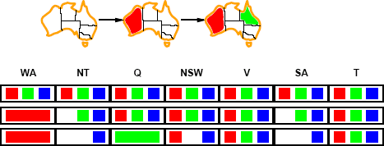
Forward checking
■
■
Assign {Q=green}
Effects on other variables connected by constraints with WA
◻
◻
◻
NT can no longer be green NSW can no longer be green SA can no longer be green
■
MRV heuristic will automatically select NT and SA next, why?

Slide 27
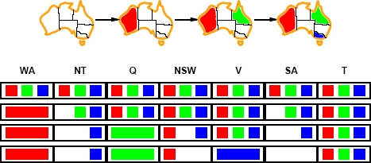
Forward checking
■
■
If V is assigned blue
Effects on other variables connected by constraints with WA
◻
◻
SA is empty
NSW can no longer be blue
■
FC has detected that partial assignment is inconsistent with the constraints and backtracking can occur.

Slide 28
Back Tracking Example
Variables = { A, B, C }
Domain = { 1, 2, 3}
Constraints = { A > B, B is not equal to C}
A = 1 → B = 1 (Constraint Broken)
A = 1 → B = 2 (Constraint Broken)
A = 1 → B = 3 (Constraint Broken)
A = 2 → B = 1 (Constraint Satisfied)
A=2 → B = 1 → C =1 (Con Violate)
A=2 B=1 C=2 (Con Satisfied)

Slide 29
CSP Algorithm Example
1
2
 | 1 | 2 | 3 | 4
Domain | RGB | RGB | RGB | RGB
3
4
V= {1, 2, 3, 4}
D= {Red, Green, Blue}
C= {1≠2, 1≠3, 1≠4, 2≠4, 3≠4}

Slide 30
CSP Algorithm Example
1
2
 | 1 | 2 | 3 | 4
Domain | RGB | RGB | RGB | RGB
1=R | R | GB | GB | GB
3
4
V= {1, 2, 3, 4}
D= {Red, Green, Blue}
C= {1≠2, 1≠3, 1≠4, 2≠4, 3≠4}

Slide 31
CSP Algorithm Example
1
2
 | 1 | 2 | 3 | 4
Domain | RGB | RGB | RGB | RGB
1=R | R | GB | GB | GB
2=G | R | G | GB | B
3
4
V= {1, 2, 3, 4}
D= {Red, Green, Blue}
C= {1≠2, 1≠3, 1≠4, 2≠4, 3≠4}

Slide 32
CSP Algorithm Example
1
2
 | 1 | 2 | 3 | 4
Domain | RGB | RGB | RGB | RGB
1=R | R | GB | GB | GB
2=G | R | G | GB | B
3=B | R | G | B | B
3
4
V= {1, 2, 3, 4}
D= {Red, Green, Blue}
C= {1≠2, 1≠3, 1≠4, 2≠4, 3≠4}

Slide 33
CSP Algorithm Example
1
2
 | 1 | 2 | 3 | 4
Domain | RGB | RGB | RGB | RGB
1=R | R | GB | GB | GB
2=G | R | G | GB | B
3=B | R | G | B | B
4=B | R | G | B | B
3
4
V= {1, 2, 3, 4}
D= {Red, Green, Blue}
C= {1≠2, 1≠3, 1≠4, 2≠4, 3≠4}

Slide 34
CSP Algorithm Example
1
2
 | 1 | 2 | 3 | 4
Domain | RGB | RGB | RGB | RGB
1=R | R | GB | GB | GB
2=G | R | G | GB | B
3=G | R | G | G | B
4=B | R | G | G | B
3
4
V= {1, 2, 3, 4}
D= {Red, Green, Blue}
C= {1≠2, 1≠3, 1≠4, 2≠4, 3≠4}

Slide 35
Example: 4-Queens Problem
X1 {1,2,3,4}
X3 {1,2,3,4}
X2 {1,2,3,4}
X4 {1,2,3,4}
1 2 3 4
1
2
3
4

Slide 36
Example: 4-Queens Problem
X1 {1,2,3,4}
X3 {1,2,3,4}
X2 {1,2,3,4}
X4 {1,2,3,4}
1 2 3 4
1
2
3
4

Slide 37
Example: 4-Queens Problem
X1 {1,2,3,4}
X3 { ,2, ,4}
X2 { , ,3,4}
X4 { ,2,3, }
1 2 3 4
1
2
3
4

Slide 38
Example: 4-Queens Problem
X1 {1,2,3,4}
X3 { ,2, ,4}
X2 { , ,3,4}
X4 { ,2,3, }
1 2 3 4
1
2
3
4

Slide 39
Example: 4-Queens Problem
X1 {1,2,3,4}
X3 { , , , }
X2 { , ,3,4}
X4 { ,2,3, }
1 2 3 4
1
2
3
4

Slide 40
Example: 4-Queens Problem
X1 { ,2,3,4}
X3 {1,2,3,4}
X2 {1,2,3,4}
X4 {1,2,3,4}
1 2 3 4
1
2
3
4

Slide 41
Example: 4-Queens Problem
X1 { ,2,3,4}
X3 {1, ,3, }
X2 { , , ,4}
X4 {1, ,3,4}
1 2 3 4
1
2
3
4

Slide 42
Example: 4-Queens Problem
X1 { ,2,3,4}
X3 {1, ,3, }
X2 { , , ,4}
X4 {1, ,3,4}
1 2 3 4
1
2
3
4

Slide 43
Example: 4-Queens Problem
X1 { ,2,3,4}
X3 {1, , , }
X2 { , , ,4}
X4 {1, ,3, }
1 2 3 4
1
2
3
4

Slide 44
Example: 4-Queens Problem
X1 { ,2,3,4}
X3 {1, , , }
X2 { , , ,4}
X4 {1, ,3, }
1 2 3 4
1
2
3
4

Slide 45
Example: 4-Queens Problem
X1 { ,2,3,4}
X3 {1, , , }
X2 { , , ,4}
X4 { , ,3, }
1 2 3 4
1
2
3
4

Slide 46
Example: 4-Queens Problem
X1 { ,2,3,4}
X3 {1, , , }
X2 { , , ,4}
X4 { , ,3, }
1 2 3 4
1
2
3
4

Slide 47
Constraint propagation
■
Solving CSPs with combination of heuristics plus forward checking is more efficient than either approach alone.
FC checking propagates information from assigned to unassigned variables but does not provide detection for all failures.
■
◻
NT and SA cannot be blue!
■
Constraint propagation repeatedly enforces constraints locally

Slide 48
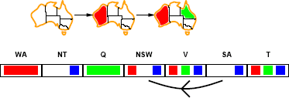
Arc consistency
■
X → Y is consistent iff
for every value x of X there is some allowed y SA → NSW is consistent iff
SA=blue and NSW=red
■

Slide 49
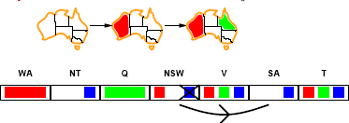
Arc consistency
■
X → Y is consistent iff
for every value x of X there is some allowed y NSW → SA is consistent iff
NSW=red and SA=blue NSW=blue and SA=???
■
Arc can be made consistent by removing blue from NSW

Slide 50
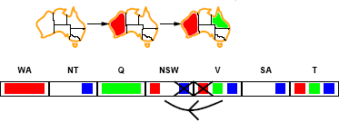
Arc consistency
■
■
Arc can be made consistent by removing blue from NSW
RECHECK neighbours !!
◻
Remove red from V

Slide 51
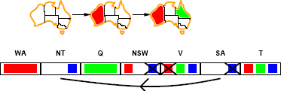
Arc consistency
■
■
Arc can be made consistent by removing blue from NSW
RECHECK neighbours !!
◻
Remove red from V
■
■
Arc consistency detects failure earlier than FC
Can be run as a preprocessor or after each assignment.
◻
Repeated until no inconsistency remains

Slide 52
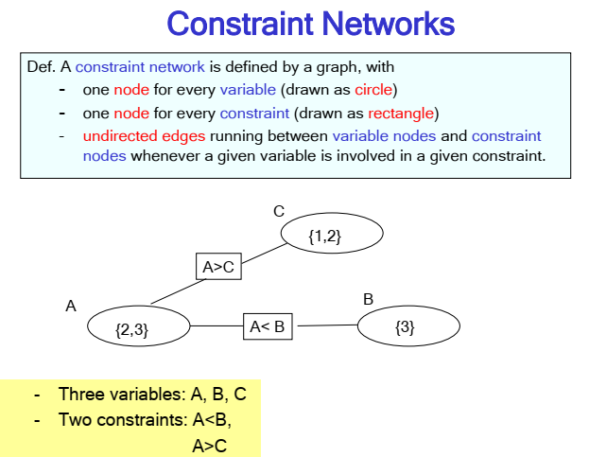

Slide 53
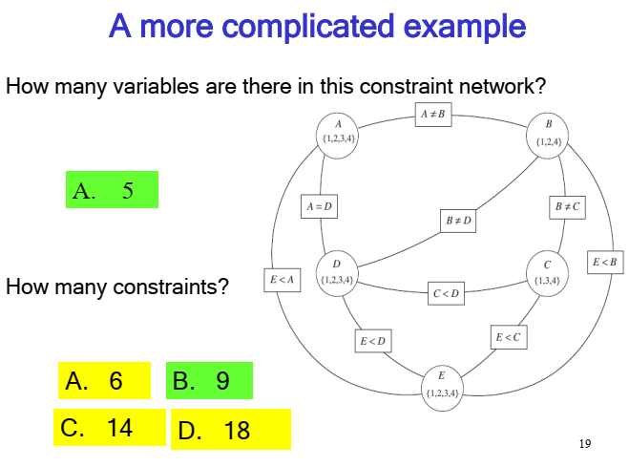

Slide 54
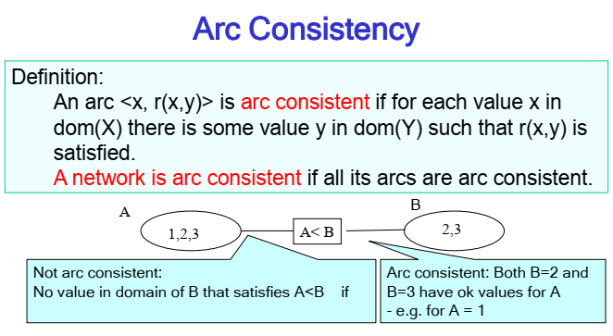

Slide 55
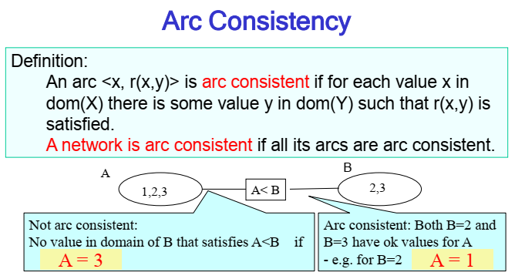

Slide 56
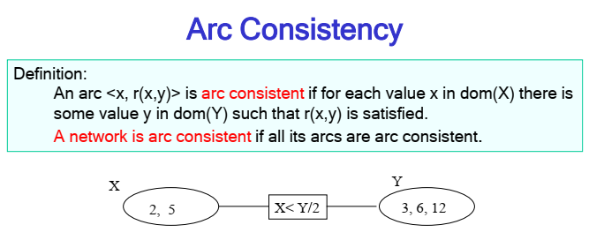
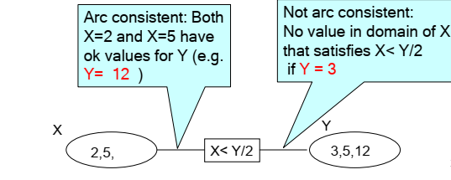

Slide 57
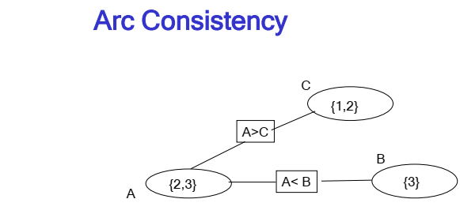

Slide 58
AC-3 Algorithm Steps:
1)Turn each binary constraint into two arcs e.g.
A>B will become A>B , B<A
2)Add all arcs to a Queue, also called as Agenda
3)Repeat Until Queue/Agenda is empty
Take an arc (Xi, Xj) from the agenda and check it
For every value of Xi there should be value of Xj
Remove/prune any inconsistent values from Xi
If Xi has changed, add all arcs of the form (Xj, Xi) to the Queue/agenda

Slide 59
Variables = { A, B, C }
Domain = { 1, 2, 3}
Constraints = { A > B, B=C}
A = { 1, 2, 3}
B= { 1, 2, 3}
C= { 1, 2, 3}
STEP 1: Turn each binary constraint into two arcs.
A>B → B<A
B=C → C=B

Slide 60
A = { 1, 2, 3}
B= { 1, 2, 3}
C= { 1, 2, 3}
Variables = { A, B, C }
Domain = { 1, 2, 3}
Constraints = { A > B, B=C}
STEP 1: Turn each binary constraint into two arcs.
A>B → B<A
B=C → C=B
STEP 2: Add all arcs to the agenda.
Agenda:
A>B
B<A
B=C
C=B

Slide 61
A = { 2, 3}
B= { 1, 2, 3}
C= { 1, 2, 3}
Variables = { A, B, C }
Domain = { 1, 2, 3}
Constraints = { A > B, B=C}
STEP 1: Turn each binary constraint into two arcs.
A>B → B<A
B=C → C=B
STEP 2: Add all arcs to the agenda.
Agenda:
A>B
B<A
B=C
C=B
STEP 3: If Xi is changed Check (Xj, Xi)

Slide 62
A = { 2, 3}
B= { 1, 2, 3}
C= { 1, 2, 3}
Variables = { A, B, C }
Domain = { 1, 2, 3}
Constraints = { A > B, B=C}
STEP 1: Turn each binary constraint into two arcs.
A>B → B<A
B=C → C=B
STEP 2: Add all arcs to the agenda.
Agenda:
A>B
B<A
B=C
C=B
STEP 3: If Xi is changed Check (Xj, Xi)

Slide 63
A = { 2, 3}
B= { 1, 2}
C= { 1, 2, 3}
Variables = { A, B, C }
Domain = { 1, 2, 3}
Constraints = { A > B, B=C}
STEP 1: Turn each binary constraint into two arcs.
A>B → B<A
B=C → C=B
STEP 2: Add all arcs to the agenda.
Agenda:
A>B
B<A
B=C
C=B
A>B
STEP 3: If Xi is changed Check (Xj, Xi)

Slide 64
A = { 2, 3}
B= { 1, 2}
C= { 1, 2, 3}
Variables = { A, B, C }
Domain = { 1, 2, 3}
Constraints = { A > B, B=C}
STEP 1: Turn each binary constraint into two arcs.
A>B → B<A
B=C → C=B
STEP 2: Add all arcs to the agenda.
Agenda:
A>B
B<A
B=C
C=B
A>B
STEP 3: If Xi is changed Check (Xj, Xi)

Slide 65
A = { 2, 3}
B= { 1, 2}
C= { 1, 2}
Variables = { A, B, C }
Domain = { 1, 2, 3}
Constraints = { A > B, B=C}
STEP 1: Turn each binary constraint into two arcs.
A>B → B<A
B=C → C=B
STEP 2: Add all arcs to the agenda.
Agenda:
A>B
B<A
B=C
C=B
A>B
B=C
STEP 3: If Xi is changed Check (Xj, Xi)

Slide 66
A = { 2, 3}
B= { 1, 2}
C= { 1, 2}
Variables = { A, B, C }
Domain = { 1, 2, 3}
Constraints = { A > B, B=C}
STEP 1: Turn each binary constraint into two arcs.
A>B → B<A
B=C → C=B
STEP 2: Add all arcs to the agenda.
Agenda:
A>B
B<A
B=C
C=B
A>B
B=C
STEP 3: If Xi is changed Check (Xj, Xi)

Slide 67
Arc consistency algorithm
function AC-3(csp) return the CSP, possibly with reduced domains
inputs: csp, a binary csp with variables {X₁, X₂, …, X_{n}}
local variables: queue, a queue of arcs initially the arcs in csp
while queue is not empty do
(X_{i}, X_{j}) ← REMOVE-FIRST(queue)
if REMOVE-INCONSISTENT-VALUES(X_{i}, X_{j}) then
for each X_{k} in NEIGHBORS[X_{i} ] do
add (X_{i}, X_{j}) to queue
function REMOVE-INCONSISTENT-VALUES(X_{i}, X_{j}) return true iff we remove a value
removed ← false
for each x in DOMAIN[X_{i}] do
if no value y in DOMAIN[X_{i}] allows (x,y) to satisfy the constraints between X_{i} and X_{j}
then delete x from DOMAIN[X_{i}]; removed ← true
return removed

Slide 68
K-consistency
Arc consistency does not detect all inconsistencies:
◻ Partial assignment {WA=red, NSW=red} is inconsistent.
Stronger forms of propagation can be defined using the notion of k-consistency.
■
A CSP is k-consistent if for any set of k-1 variables and for any consistent assignment to those variables, a consistent value can always be assigned to any kth variable.
E.g. 1-consistency or node-consistency
E.g. 2-consistency or arc-consistency
E.g. 3-consistency or path-consistency

Slide 69
K-consistency
A graph is strongly k-consistent if
It is k-consistent and
Is also (k-1) consistent, (k-2) consistent, … all the way down to 1-consistent.
This is ideal since a solution can be found in time O(nd)
instead of O(n²d³)
YET no free lunch: any algorithm for establishing n- consistency must take time exponential in n, in the worst case.

Slide 70
Further improvements
■
Checking special constraints
◻
Checking Alldif(…) constraint
■
E.g. {WA=red, NSW=red}
◻
Checking Atmost(…) constraint
■
Bounds propagation for larger value domains
■
Intelligent backtracking
◻
Standard form is chronological backtracking i.e. try different value for preceding variable.
More intelligent, backtrack to conflict set.
◻
■
Set of variables that caused the failure or set of previously assigned variables that are connected to X by constraints.
Backjumping moves back to most recent element of the conflict set. Forward checking can be used to determine conflict set.
■
■

Slide 71
Local search for CSP
Use complete-state representation
For CSPs
allow states with unsatisfied constraints
operators reassign variable values
Variable selection: randomly select any conflicted variable
Value selection: min-conflicts heuristic
Select new value that results in a minimum number of conflicts with the other variables

Slide 72
Local search for CSP
function MIN-CONFLICTS(csp, max_steps) return solution or failure
inputs: csp, a constraint satisfaction problem
max_steps, the number of steps allowed before giving up
current ← an initial complete assignment for csp
for i = 1 to max_steps do
if current is a solution for csp then return current
var ← a randomly chosen, conflicted variable from VARIABLES[csp]
value ← the value v for var that minimizes CONFLICTS(var,v,current,csp) set var = value in current
return faiilure

Slide 73

Min-conflicts example 1
h=5 h=3 h=1
■ Use of min-conflicts heuristic in hill-climbing.

Slide 74
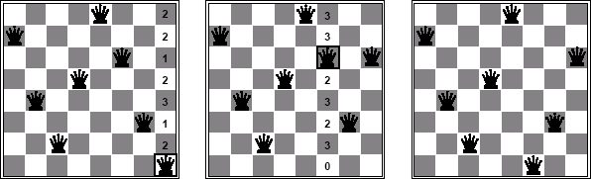
Min-conflicts example 2
■
A two-step solution for an 8-queens problem using min-conflicts heuristic.
At each stage a queen is chosen for reassignment in its column.
The algorithm moves the queen to the min-conflict square breaking ties randomly.
■
■

Slide 75
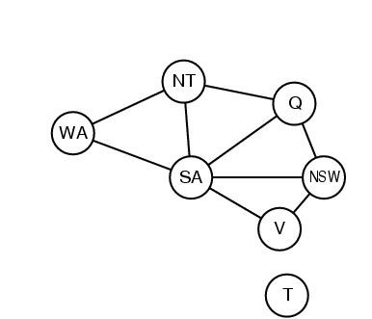
Problem structure
■
■
How can the problem structure help to find a solution quickly?
Subproblem identification is important:
◻
◻
Coloring Tasmania and mainland are independent subproblems Identifiable as connected components of constrained graph.
■
Improves performance

Slide 76
Problem structure
■
■
Suppose each problem has c variables out of a total of n. Worst case solution cost is O(n/c d^{c}), i.e. linear in n
◻
Instead of O(d ^{n}), exponential in n
■
E.g. n= 80, c= 20, d=2
◻
◻
2⁸⁰ = 4 billion years at 1 million nodes/sec.
4 * 2²⁰= .4 second at 1 million nodes/sec

Slide 77
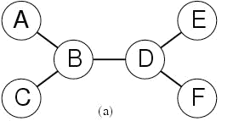
Tree-structured CSPs
■
Theorem: if the constraint graph has no loops then CSP can be solved in O(nd ²) time
Compare difference with general CSP, where worst case is
O(d ^{n})
■

Slide 78
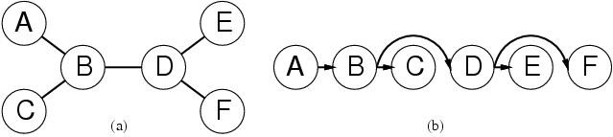
Tree-structured CSPs
■
■
In most cases subproblems of a CSP are connected as a tree
Any tree-structured CSP can be solved in time linear in the number of variables.
◻
Choose a variable as root, order variables from root to leaves such that every node’s parent precedes it in the ordering.
For j from n down to 2, apply REMOVE-INCONSISTENT-VALUES(Parent(X_{j}),X_{j})
For j from 1 to n assign X_{j} consistently with Parent(X_{j} )
◻
◻

Slide 79
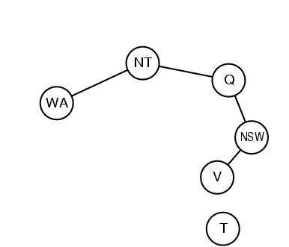
Nearly tree-structured CSPs
Can more general constraint graphs be reduced to trees?
Two approaches:
Remove certain nodes
Collapse certain nodes

Slide 80
Nearly tree-structured CSPs
■
Idea: assign values to some variables so that the remaining variables form a tree.
Assume that we assign {SA=x} ← cycle cutset
■
◻
And remove any values from the other variables that are inconsistent.
The selected value for SA could be the wrong one so we have to try all of them
◻

Slide 81
Nearly tree-structured CSPs
■
■
This approach is worthwhile if cycle cutset is small. Finding the smallest cycle cutset is NP-hard
◻
Approximation algorithms exist
■
This approach is called cutset conditioning.

Slide 82
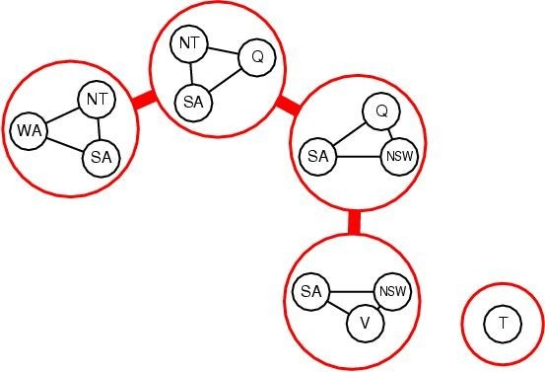
Nearly tree-structured CSPs
■
Tree decomposition of the constraint graph in a set of connected subproblems.
Each subproblem is solved independently
Resulting solutions are combined. Necessary requirements:
■
■
■
◻
Every variable appears in ar least one of the subproblems.
If two variables are connected in the original problem, they must appear together in at least one subproblem.
If a variable appears in two subproblems, it must appear in eacht node on the path.
◻
◻

Slide 83
Summary
■
CSPs are a special kind of problem: states defined by values of a fixed set of variables, goal test defined by constraints on variable values
Backtracking=depth-first search with one variable assigned per node Variable ordering and value selection heuristics help significantly Forward checking prevents assignments that lead to failure.
Constraint propagation does additional work to constrain values and detect inconsistencies.
The CSP representation allows analysis of problem structure. Tree structured CSPs can be solved in linear time.
Iterative min-conflicts is usually effective in practice.
■
■
■
■
■
■
■

